Slide 1
Neonatal Resuscitation
2010 AHA Guidelines for Cardiopulmonary Resuscitation and Emergency
Cardiovascular Care
ThS.BS. NGUYỄN KIẾN MẬU

Slide 2
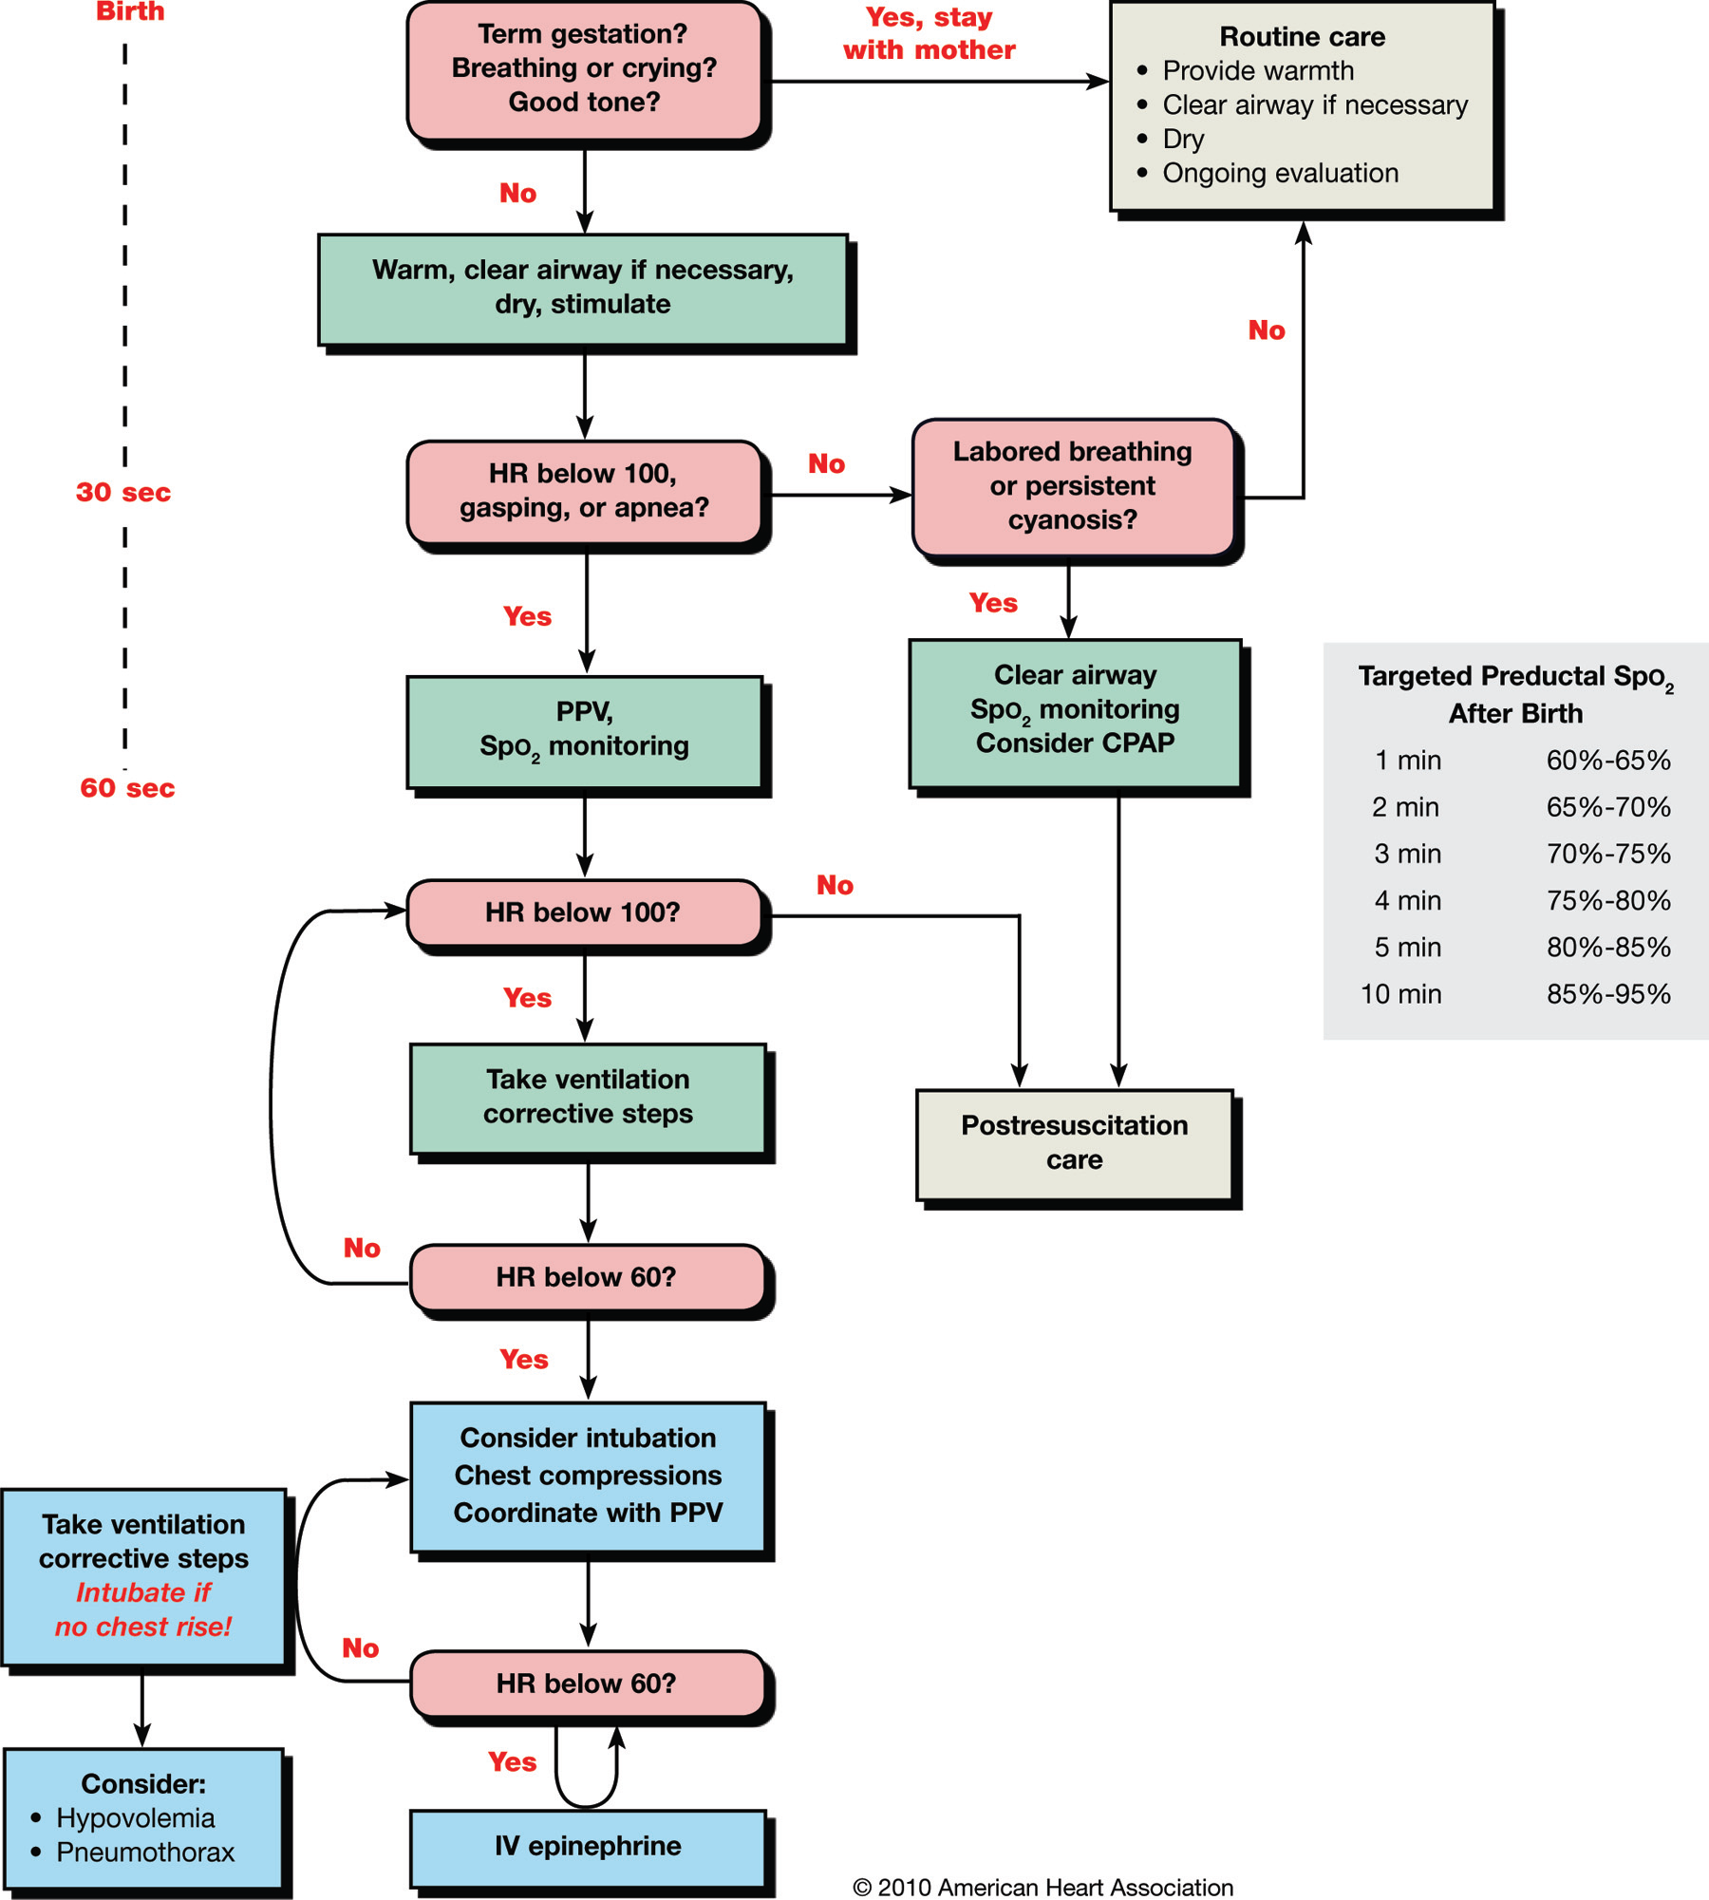

Slide 3
Assessment of heart rate should be done by intermittently auscultating the precordial pulse. When a pulse is detectable, palpation of the umbilical pulse can also provide a rapid estimate of the pulse and is more accurate than palpation at other sites.
A pulse oximeter can provide a continuous assessment of the pulse without interruption of other resuscitation measures, but the device takes 1 to 2 minutes to apply, and it may not function during states of very poor cardiac output or perfusion.

Slide 4
- Once positive pressure ventilation or supplementary oxygen administration is begun, assessment should consist of simultaneous evaluation of 3 vital characteristics: heart rate, respirations, and the state of oxygenation
- The most sensitive indicator of a successful response to each step is an increase in heart rate.

Slide 5
Temperature Control
Prewarming the delivery room to 26°C, covering the baby in plastic wrapping (food or medical grade, heat-resistant plastic) (Class I, LOE A), placing the baby on an exothermic mattress (Class IIb, LOE B),and placing the baby under radiant heat(Class IIb, LOE C).
Prewarming the linen, drying and swaddling,placing the baby skin-to-skin withthe mother and covering both with a blanket) and are recommended, but they have not been studied specifically (Class IIb, LOE C)

Slide 6
Clearing the Airway
When Amniotic Fluid Is Clear: suctioning immediately following birth (including suctioning with a bulb syringe) should be reserved for babies who have obvious obstruction to spontaneous breathing or who require positive-pressure ventilation (PPV) (Class IIb, LOE C).
When Meconium is Present : there is insufficient evidence to recommend a change in the current practice of performing endotracheal suctioning of nonvigorous babies with meconium-stained amnioticfluid (Class IIb, LOE C). However, if attempted intubation is prolonged and unsuccessful, bag-mask ventilation should be considered, particularly if there is persistent bradycardia.

Slide 7
Assessment of Oxygen Need and Administration of Oxygen
Pulse Oximetry: when positive pressure is administered for more than a few breaths, when cyanosis is persistent, or when supplementary oxygen is administered (Class I, LOE B).
Administration of Supplementary Oxygen: initiating resuscitation with air or a blended oxygen and titrating the oxygen concentration to achieve an SpO2 in the target range asdescribed above using pulse oximetry(Class IIb, LOE C). If blended oxygen is not available, resuscitation should be initiated with air (Class IIb, LOE B). If the baby is bradycardic (HR 60 perminute) after 90 seconds of resuscitation with a lower concentration of oxygen,oxygen concentration should be increased to 100% until recovery of a normal heart rate (Class IIb, LOE B).

Slide 8
Positive-Pressure Ventilation (PPV)
If the infant remains apneic or gasping, or if the heart rate remains 100 per minute after administering the initial steps, start PPV.

Slide 9
Initial Breaths and
Assisted Ventilation
- Assisted ventilation should be delivered at a rate of 40 to 60 breaths per minute to promptly achieve or maintain a heart rate 100 per minute (Class IIb, LOE C).
- Inflation pressure should be monitored; an initial inflation pressure of 20 cm H2O may be effective, but 30 to 40 cm H2O may be required insome term babies without spontaneous ventilation (Class IIb, LOE C).

Slide 10
Endotracheal Tube Placement
Endotracheal intubation may be indicated at several points during neonatal resuscitation:
● Initial endotracheal suctioning of nonvigorous meconium-stained newborns
● If bag-mask ventilation is ineffective or prolonged
● When chest compressions are performed
● For special resuscitation circumstances, such as congenital diaphragmatic hernia or extremely low birth weight

Slide 11
Chest Compressions
Chest compressions are indicated for a heart rate that is 60 per minute despite adequate ventilation with supplementary oxygen for 30 seconds.
Because the 2 thumb–encircling hands technique may generate higher peak systolic and coronary perfusion pressure than the 2-finger technique, the 2 thumb–encircling hands technique is recommended for performing chest compressions in newly born infants (Class IIb, LOE C).

Slide 12
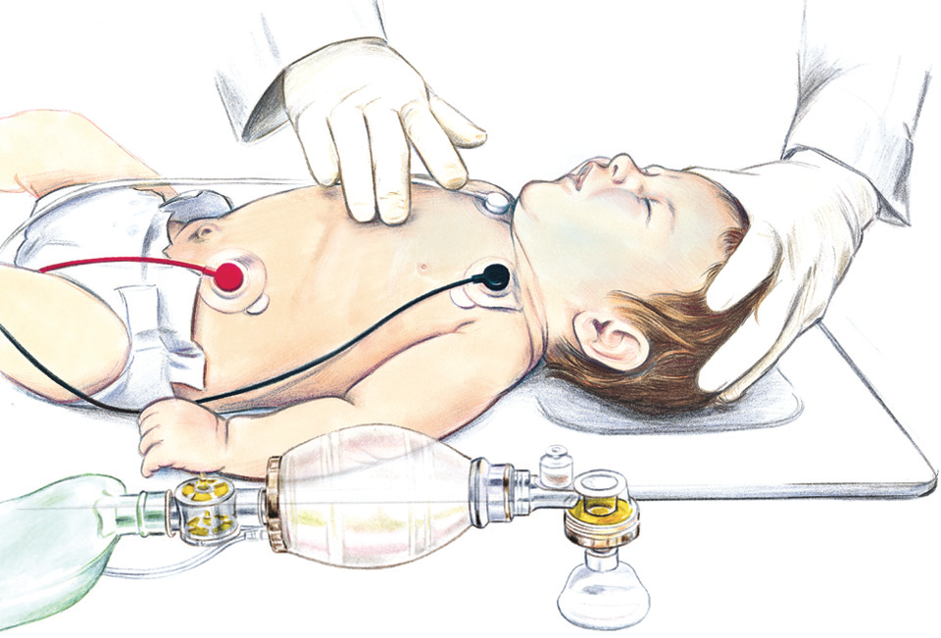
Two-finger chest compression technique in infant (1 rescuer).

Slide 13
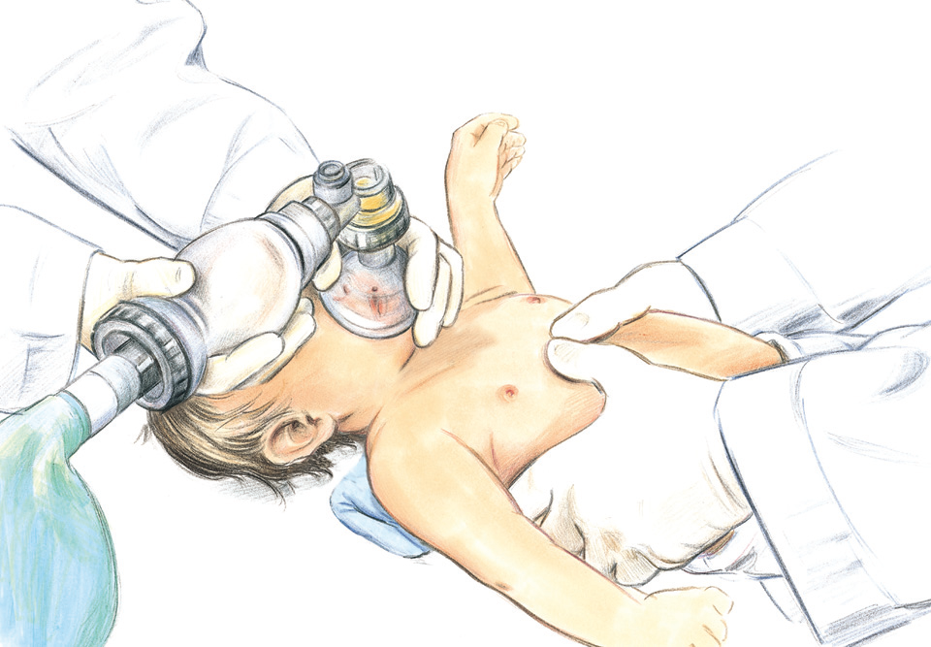
Two thumb-encircling hands chest compression in infant (2 rescuers).

Slide 14
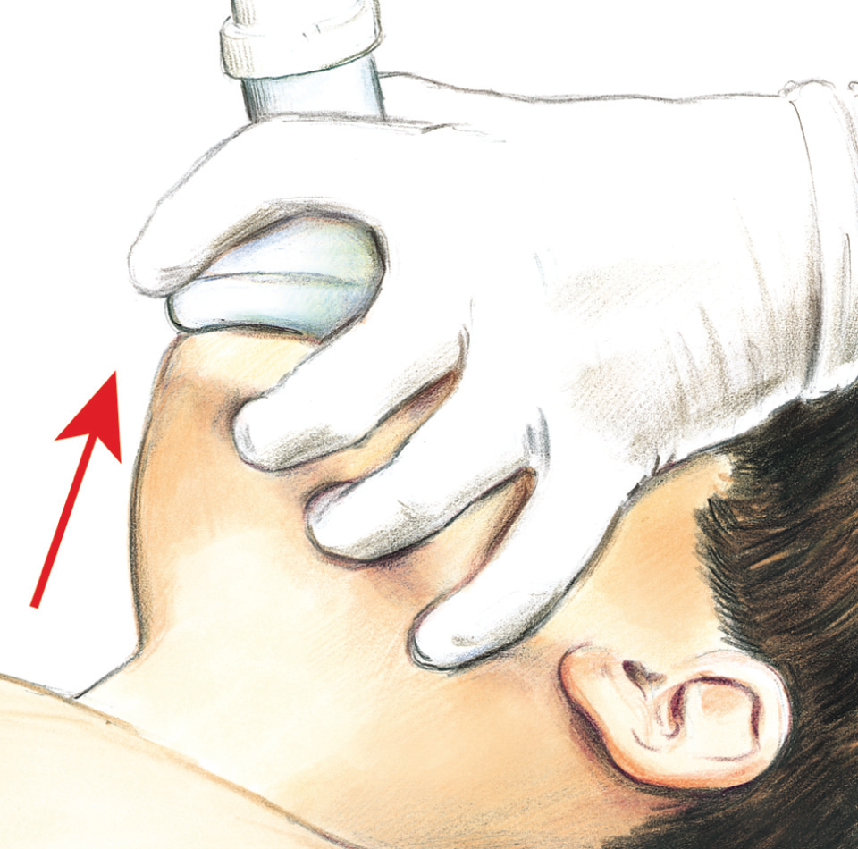
The EC clamp technique of bag-mask ventilations. Three fingers of one hand lift the jaw (they form the “E”) while the thumb and index finger hold the mask to the face (making a “C”).

Slide 15
Chest Compressions
It is recommended that a 3:1 compression to ventilation ratio be used for neonatal resuscitation where compromise of ventilation is nearly always the primary cause, but rescuers should consider using higher ratios (eg, 15:2) if the arrest is believed to be of cardiac origin (Class IIb, LOE C).)
Respirations, heart rate, and oxygenation should be reassessed periodically, and coordinated chest compressions and ventilations should continue until the spontaneous heart rate is ≥60 per minute (Class IIb, LOE C).

Slide 16
MEDICATIONS
if the heart rate remains < 60 per minute despite adequate ventilation (usually with endotracheal intubation) with 100% oxygen and chest compressions, administration of epinephrine or volume expansion, or both, may be indicated.

Slide 17
Rate and Dose of
Epinephrine Administration
IV administration of 0.01 to 0.03 mg/kg per dose is the preferred route. While access is being obtained, administration of a higher dose (0.05 to 0.1 mg/kg) through the endotracheal tube may be considered, but the safety and efficacy of this practice have not been evaluated (Class IIb, LOE C).

Slide 18
VOLUME EXPANSION
Should be considered when blood loss is known or suspected (pale skin, poor perfusion, weak pulse) and the baby’s heart rate has not responded adequately to other resuscitative measures (Class IIb, LOE C).
An isotonic crystalloid solution or blood is recommended for volume expansion in the delivery room (Class IIb, LOE C). The recommended dose is 10mL/kg, which may need to be repeated. When resuscitating premature infants, care should be taken to avoid giving volume expanders rapidly, because rapid infusions of large volumes have been associated with intraventricular hemorrhage (Class IIb, LOE C).

Slide 19
GUIDELINES FOR WITHHOLDING
RESUSCITATION
When gestation, birth weight, or congenital anomalies are associated with almost certain early death and when unacceptably high morbidity is likely among the rare survivors, resuscitation is not indicated. ( Ex: extreme prematurity (gestational age 23 weeks or birth weight 400 g), anencephaly, and some major chromosomal abnormalities, such as trisomy 13 (Class IIb, LOE C).
● In conditions associated with a high rate of survival and acceptable morbidity,resuscitation is nearly always indicated.

Slide 20
GUIDELINES FOR WITHHOLDING
RESUSCITATION
This will generally include babies with gestational age 25 weeks and those with most congenital malformations (Class IIb,LOE C).
● In conditions associated with uncertain prognosis in which survival is borderline, the morbidity rate is relatively high, and the anticipated burden to the child is high, parental desires concerning initiation of resuscitation should be supported (Class IIb, LOE C).

Slide 21
Discontinuing Resuscitative Efforts
In a newly born baby with no detectable heart rate, it is appropriate to consider stopping resuscitation if the heart rate remains undetectable for 10 minutes (Class IIb, LOE C).

Slide 23

Basic life support
CAB not ABC

Slide 24
Cardiac arrest out -of-hospital resuscitation
Out-of-hospital survival rates and neurological outcome can be improved with prompt bystander CPR.
survival rates 70% have been reported with good neurologic outcome.
Bystander resuscitation have substantial impact on survival from primary VF because survival rates of 20% to 30% sudden out-of-hospital witnessed VF
But 1/3 received bystander CPR

Slide 25
Cardiac arrest in-hospital resuscitation
Overall survival: 27%.
  poor perfusion and bradycardia 64%
  Pulseless electric activity 38%
  VF/pulseless VT 34%
  Asystole 24%
Dr Abella (Chicago Univ Hospital)
  suboptimal rate < 100: 28,1%
  shallow 37,4%
  Ventilation rates high 60,9%
  Interrupt: often

Slide 26
Basic life support
2000
 | Nhuõ nhi | Treû nhoû | Treû lôùn
Tyû leä hoài söùc tim phoåi | 5:1 | 5:1 | 15:2
2005 & 2010
 | Nhuõ nhi | Treû nhoû < 8 tuoåi | Treû lôùn ≥ 8 tuoåi
Tyû leä hoài söùc tim phoåi
1 ngöôøi hoài söùc | 30 : 2 | 30 : 2 | 30 : 2
2 ngöôøi hôøi söùc | 15: 2 |  | 30 : 2

Slide 27
ABC OR CAB?
2000, 2005: recommended sequence of CPR previously “ABC”- airway, breathing, compression.
The 2010 AHA Guidelines for CPR recommend a CAB sequence (chest compressions, airway breathing/ventilations).
During cardiac arrest high-quality CPR, particularly high-quality chest compressions are essential to generate blood flow to vital organs and to achieve ROSC

Slide 28
CAB Not ABC
Adult:
VF cardiac arrest in whom compressions are more important than ventilations.
They have a better outcome if chest compressions are started as early as possible with minimal interruptions.
Beginning CPR with 30 compressions rather than 2 ventilations leads to a shorter delay to first compression in adult studies

Slide 29
CAB Not ABC
All rescuers: start chest compressions almost immediately. In contrast, positioning the head and attaining a seal for mouthto- mouth or a bag-mask apparatus for rescue breathing take time and delays the initiation of chest compressions.

Slide 30
CAB not ABC
Hands-Only (Compression-Only) CPR
Research | Criteria | bystander | Hands-Only
SOS-Kanto 2002-03 | Recover good neurologic signs 30 days | 30/712 (4%) | 27/439 (6%)
Iwami 1998-03 | Survival and good recover of neurologiic | 28/783 (3,6%) | 19/544 (3,5%)
Bohm 1990-05 | Survival after 1 year | 591/8209 (7%) | 77/1145 (7%)

Slide 31
CAB not ABC
Hands-Only (Compression-Only) CPR
Hands-Only (Compression-Only) CPR: child-animal
  VF: hands only sufficient to resuscitaion.
  Asphyxial: Compression + ventilation: better
Child:
chest compression + Mouth –to –mouth better than Chest compression (noncardiac)
Hands only bystander = chest compression + Mouth –to –mouth (cardiac)

Slide 32
CAB Not ABC
Asphyxial cardiac: infant and child
Recent large pediatric study show that resuscitation results for asphyxial arrest are better with a combination of ventilations + compression
however, unknown whether it makes a difference if the sequence begins with ventilations (ABC) or with chest compressions (CAB)
Starting CPR with 30 compressions followed by 2 ventilations should theoretically delay ventilations by only about 18 seconds for the lone rescuer and by an even a shorter interval for 2 rescuers.

Slide 33
CAB Not ABC
The CAB sequence for infants and children is recommended in order to simplify training with the hope that more victims of sudden cardiac arrest will receive bystander CPR.

Slide 34
BLS SEQUENCE
Lay rescurer
Health care provider

Slide 35
BLS SEQUENCE
Lay | Profession
Unresponsive, not breathing (gasping) | Unresponsive, not breathing (gasping)
Start Chest Compressions | Pulse Check
Open the Airway and Give Ventilations | Chest Compressions (no pulse)
Coordinate Chest: Compressions and Breathing 30: 2 (2 minutes – 5 cycles) | Ventilation
Activate Emergency Response System: 2 rescuers lone rescuer | Coordinate Chest Compressions and Ventilations 30: 2 or 15: 2 Defibrillation: AED successfully, minimal myocardial damage, good neurological outcomes

Slide 36
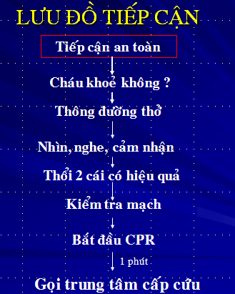
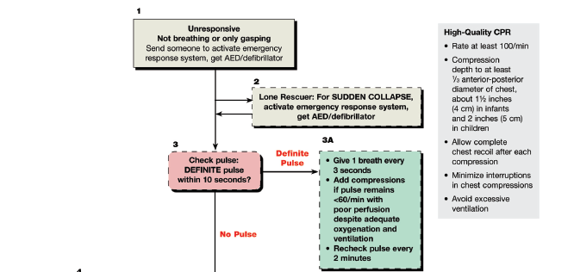

BLS SEQUENCE

Slide 37
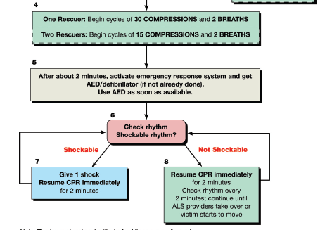

Slide 38
Breathing Adjuncts
Barrier devices have not reduced the low risk of transmission of infection and some may increase resistance to air flow
Mouth-to-mouth rescue breathing without a barrier device
Bag-Mask Ventilation:
  450 to 500 mL or 1000 mL
  Maintain an oxygen flow of 10 to 15 L/min into a reservoir attached to a pediatric bag

Slide 39
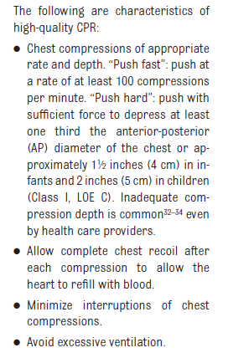

Slide 40
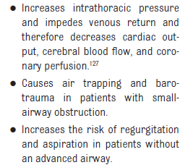
Excessive ventilation is harmful:

Slide 41
